Slide 1
2013_09_09
Start building vectors for more promoter probe testing

Slide 2
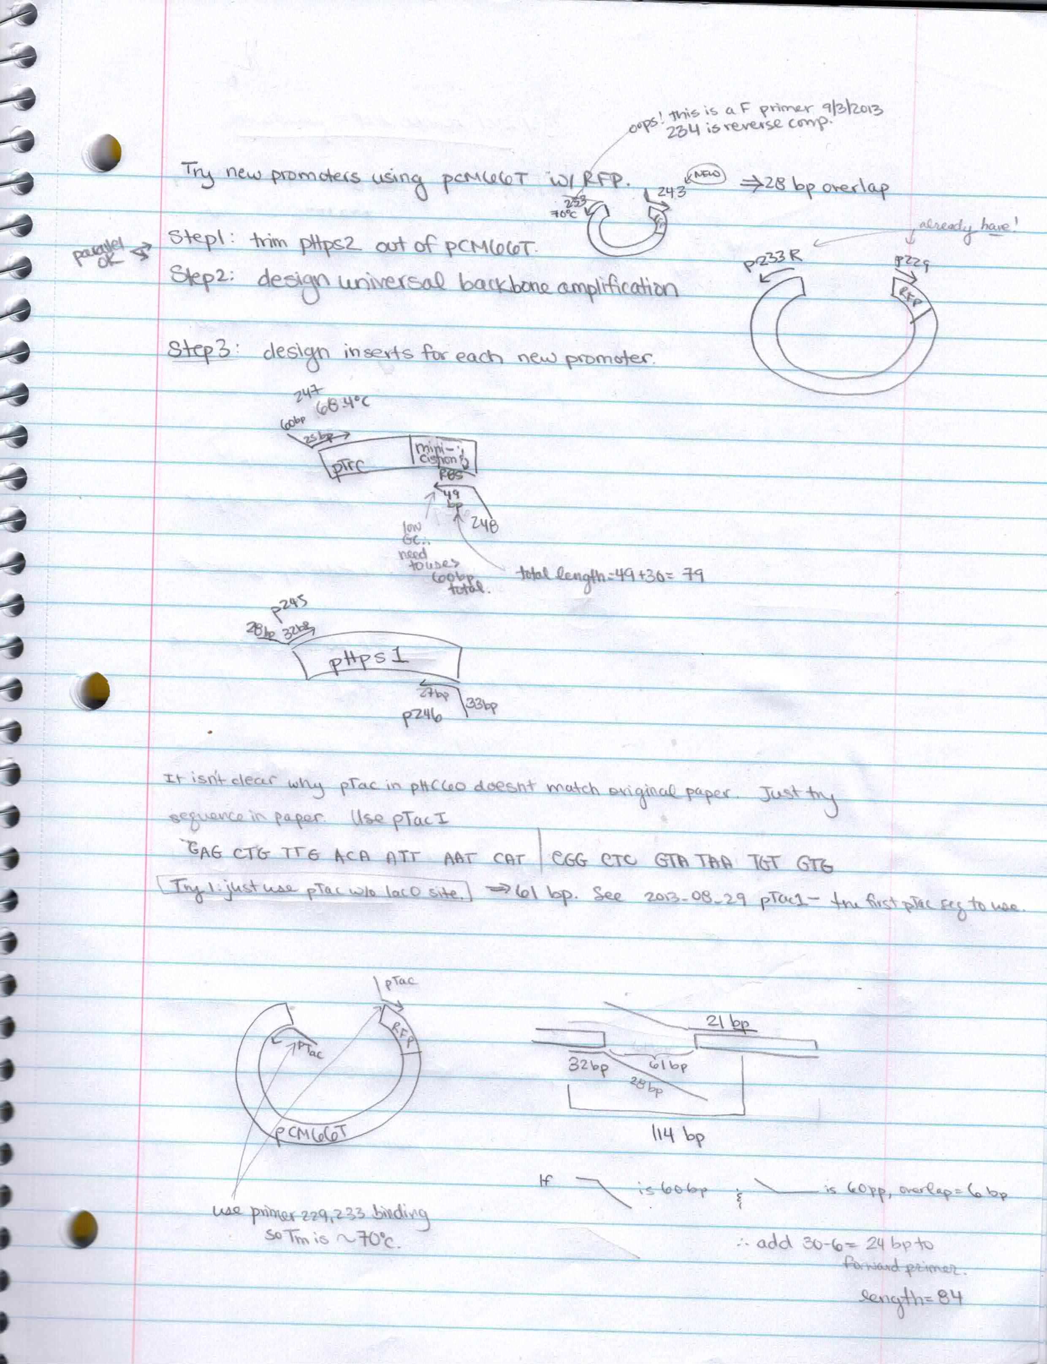
Actually reverse primer 234 (reverse complement of 233)

Slide 3
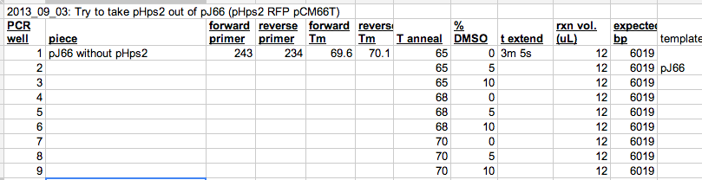
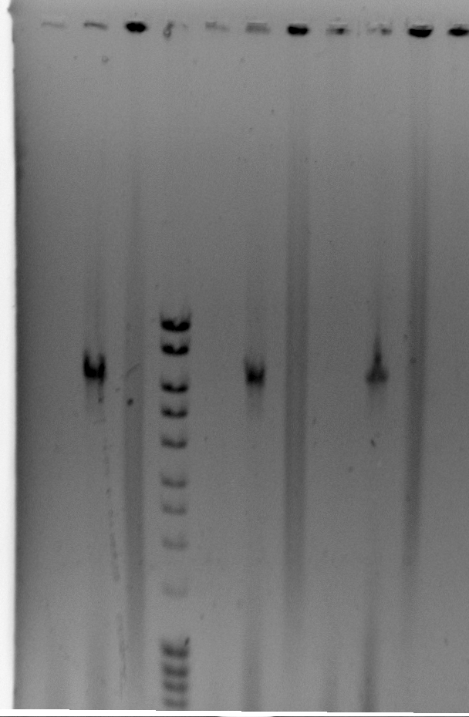
2013_09_03 remove pHps2 from pJ66 (pHps2 RFP pCM66T)

Slide 4
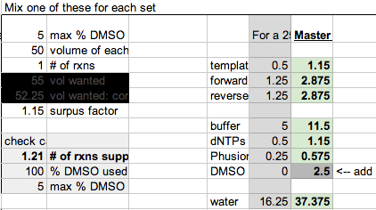
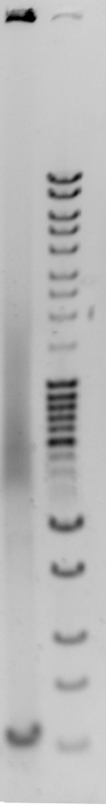
2013_09_03 remove pHps2 from pJ66 (pHps2 RFP pCM66T)
Results show no amplification. Used a different thermocycler (white eppendorf first, then black thermocycler 2nd) so try again in white thermocycler when I have time.

Slide 5
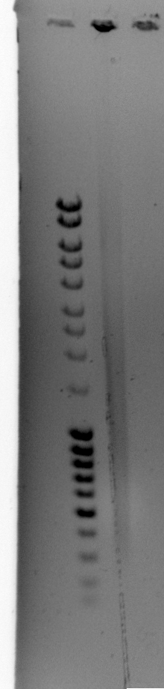
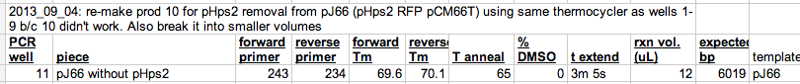
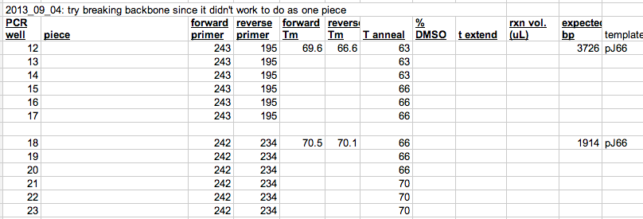
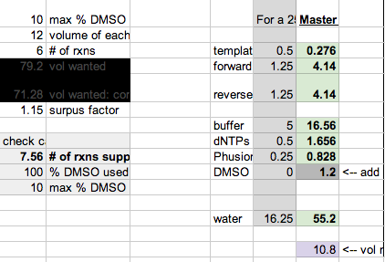
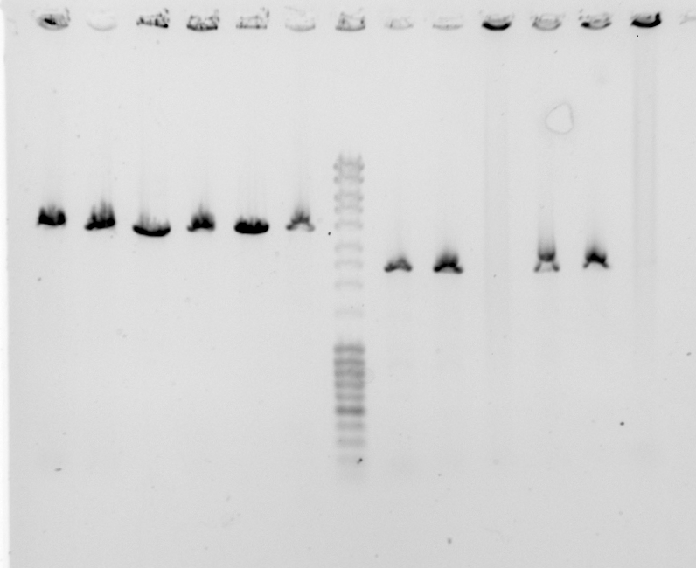
2013_09_03 remove pHps2 from pJ66 (pHps2 RFP pCM66T)

Slide 6
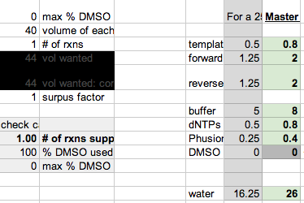
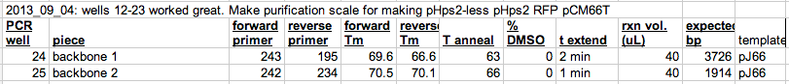
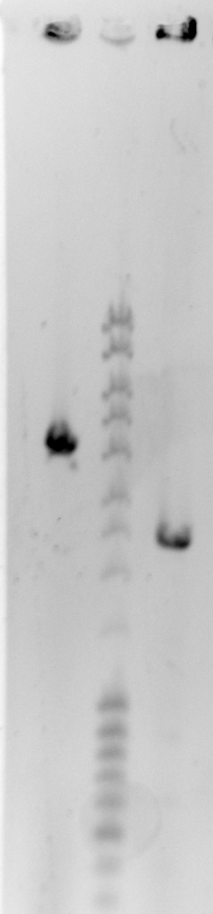
2013_09_03 remove pHps2 from pJ66 (pHps2 RFP pCM66T)
Dpn1 treat before cleanup later

Slide 7
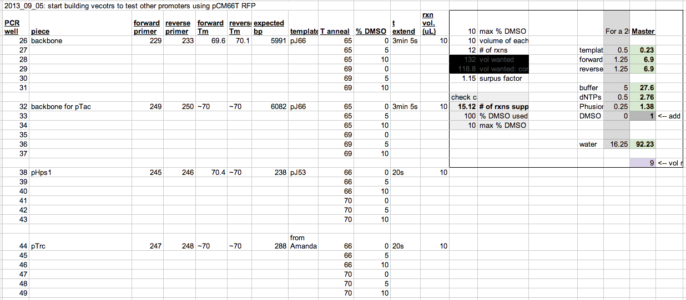
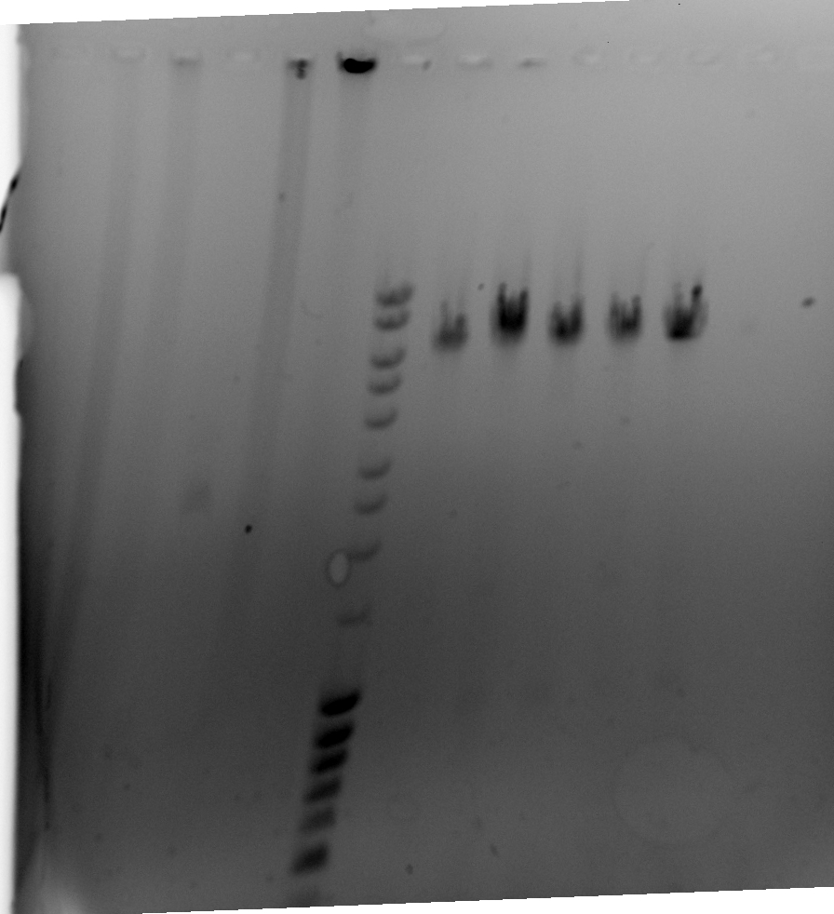
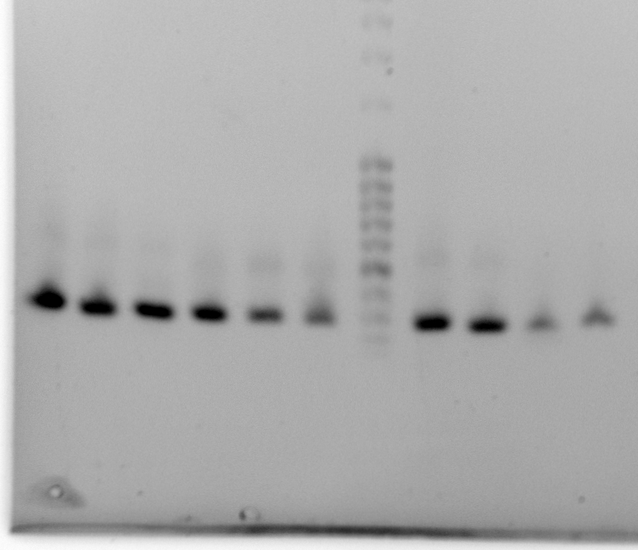
2013_09_05 prepare for pTrc, pTac, pHps1
Wells 26-37. Should have used primer 234, not 233 for 26-31
Wells 38-40, 44-46, 41-43, 47-49 all good but do purification scale of wells 38 and 44

Slide 8
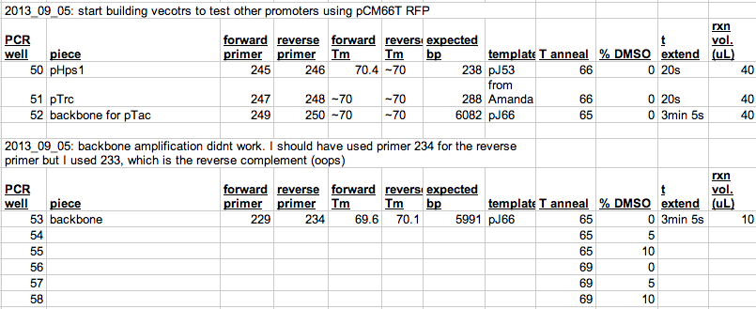
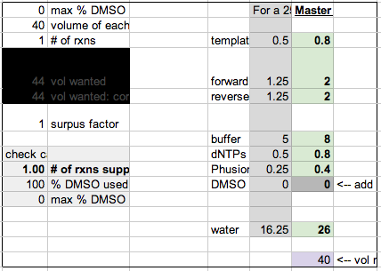
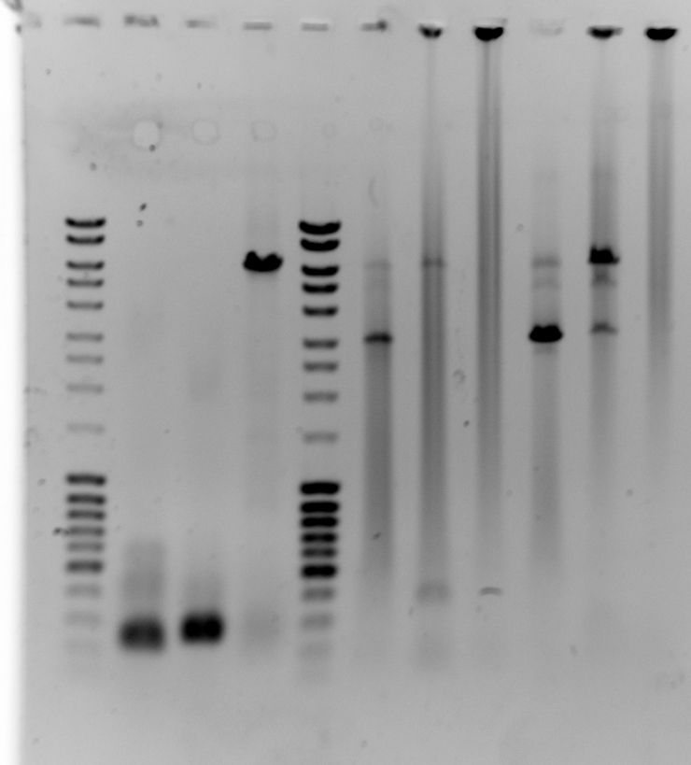
2013_09_05 prepare for pTrc, pTac, pHps1
Wells 50-52 look good. Add Dpn1 and put at 37oC until purification scale version of 53-58 is ready.
Make 120 uL of backbone w/ 0% DMSO and 69oC annealing.
Oops… should have done 5% DMSO at 69oC for purification scale but I did 0% in well 60. Doing well 61 correctly.

Slide 9
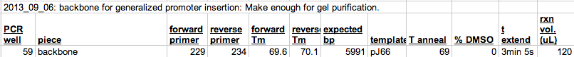
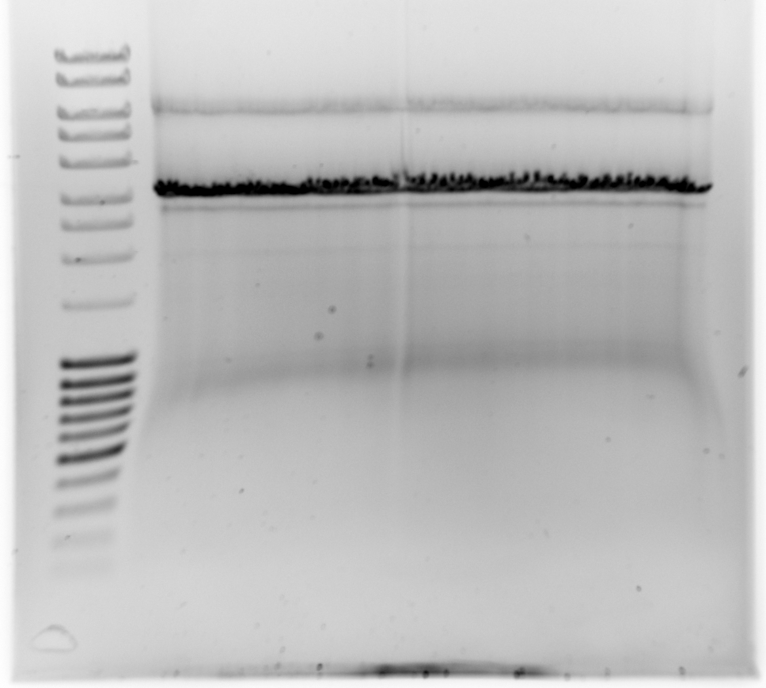
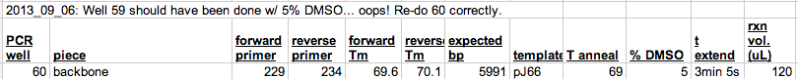
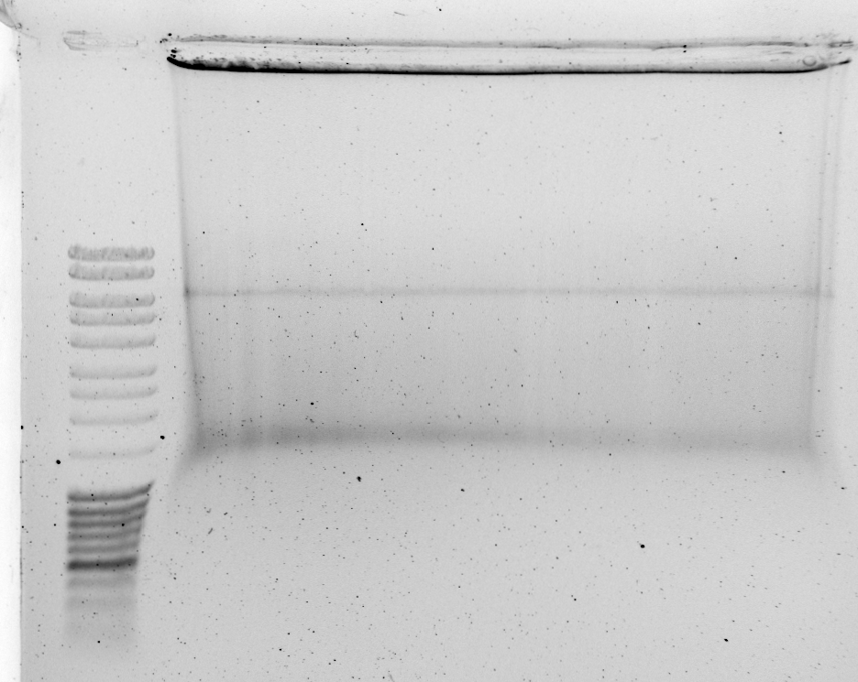
2013_09_05 prepare for pTrc, pTac, pHps1
Desired product
Added 0.5 uL Dpn1, incubate 3 hrs at 37oC

Slide 10
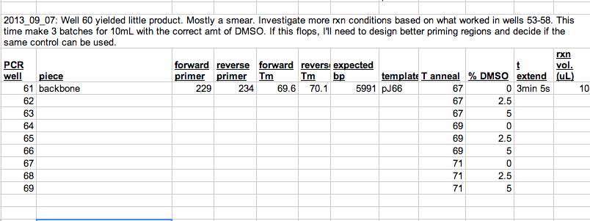
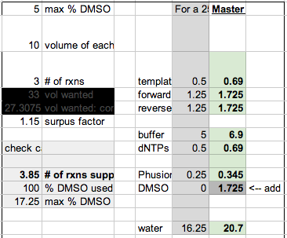
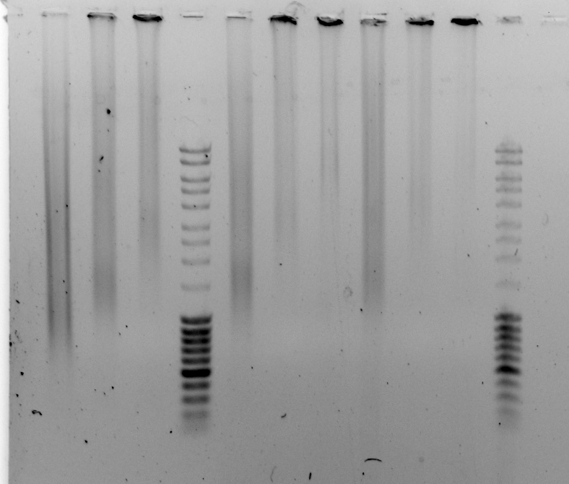
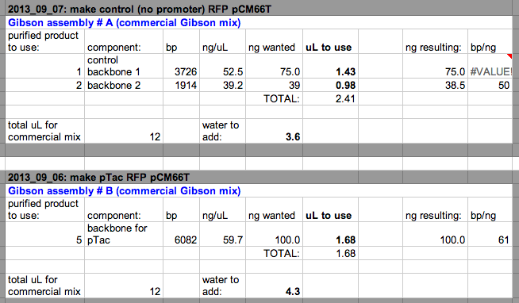
2013_09_05 prepare for pTrc, pTac, pHps1
Try harder to find a good backbone for the generic backbone piece used to put in promoter regions… well 60 looked bad.
Wells 61-69 didn’t work.

Slide 11
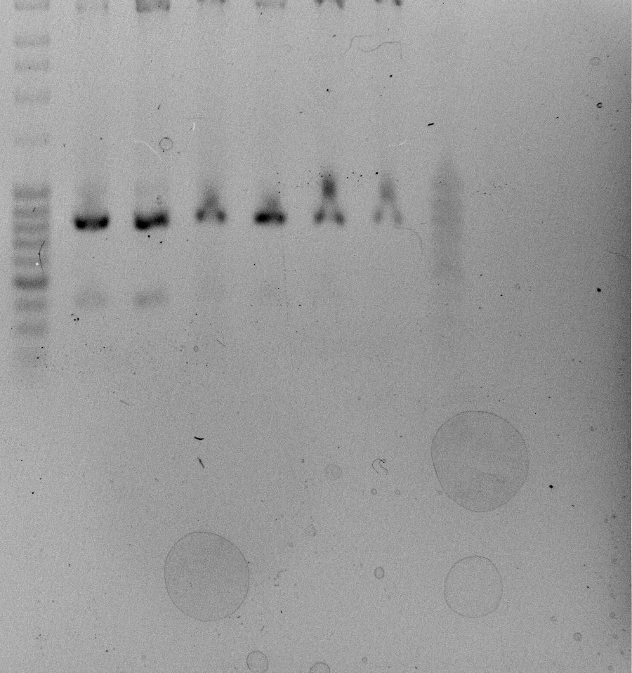
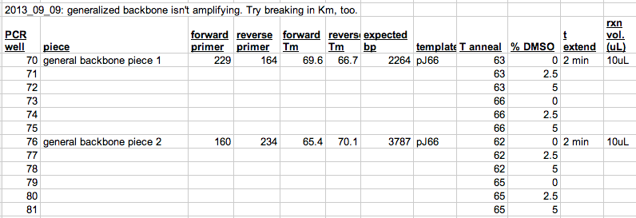
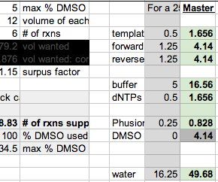
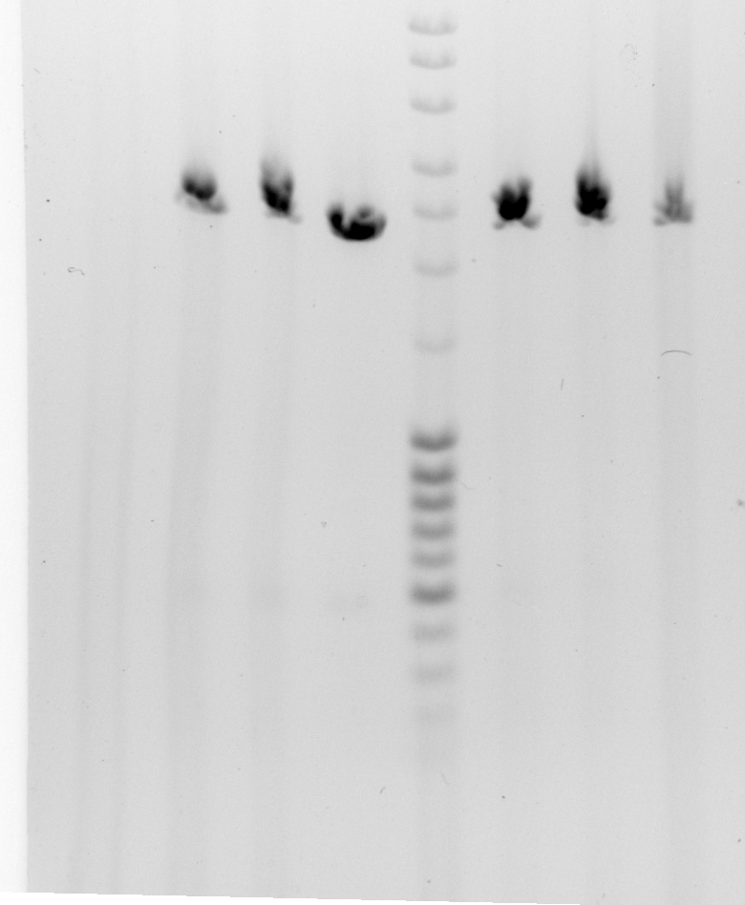
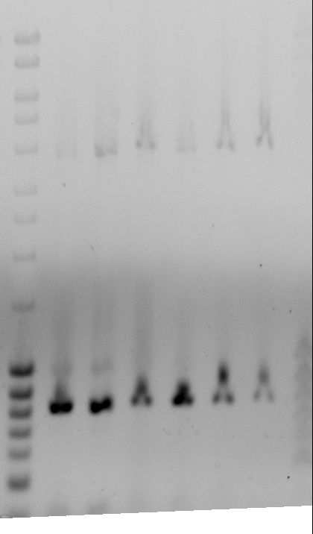
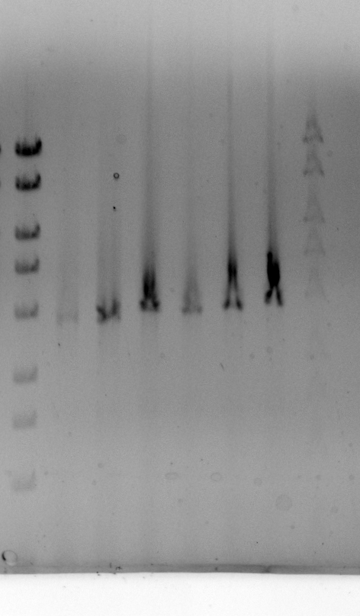
2013_09_05 make generalized backbone
Wells 76-81 are too small.
Expect 3787, got 800 bp. Product is ~ 2990 bp too small.
Were the previous failed amplifications too short by the same amount?
Look ~2000 bp too short but this is within error…
There aren’t any suspicious BLAST hits anywhere in the plasmid
Wells 76-81: left gel is before dye penetrated. Right is after bottom bands ran off.
Make purification scale of #81
Wells 70-75 look good

Slide 12
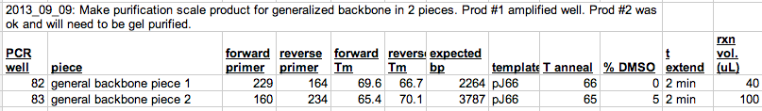
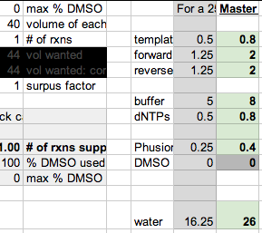
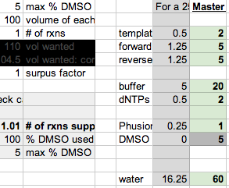
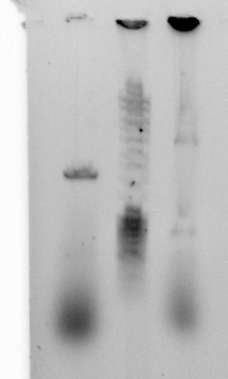
2013_09_05 make generalized backbone

Slide 13
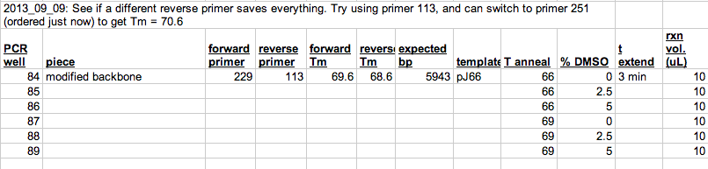
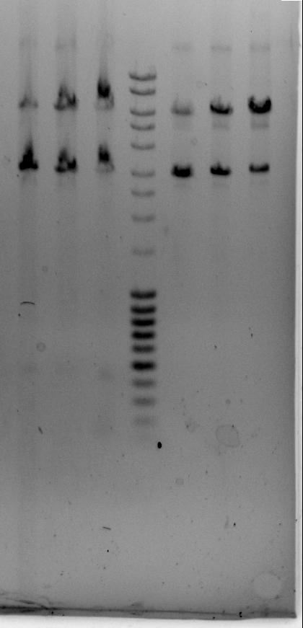
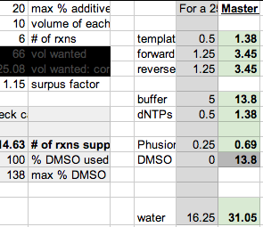
2013_09_05 make generalized backbone

Slide 14
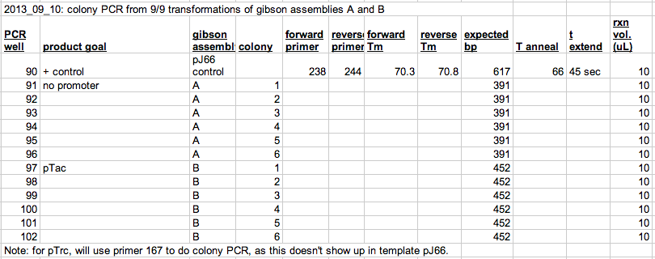
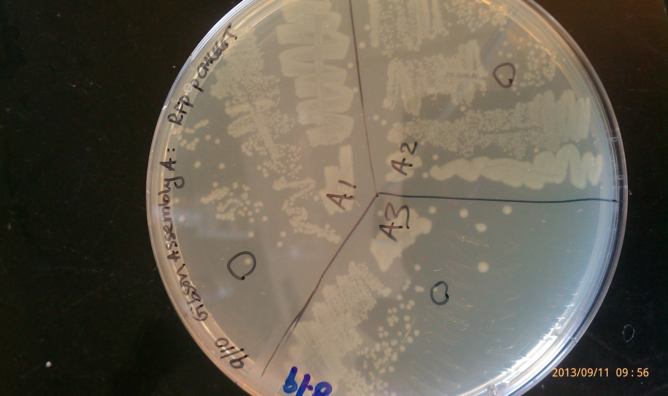
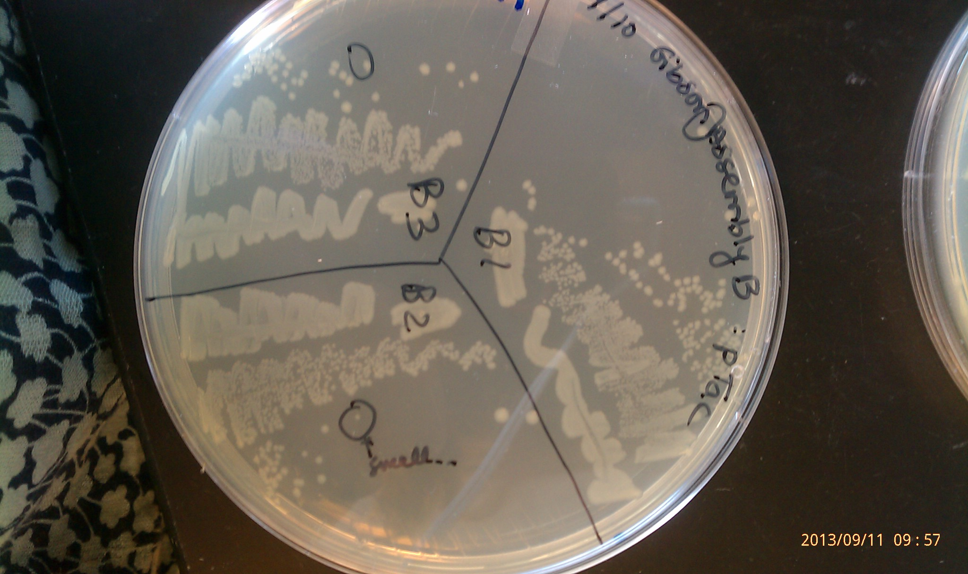
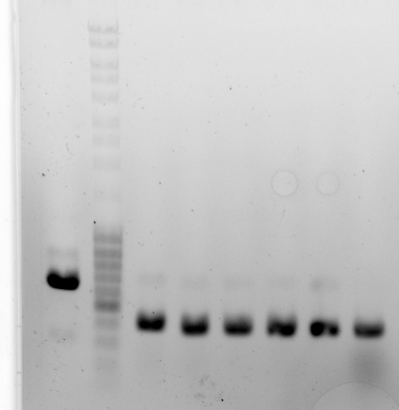
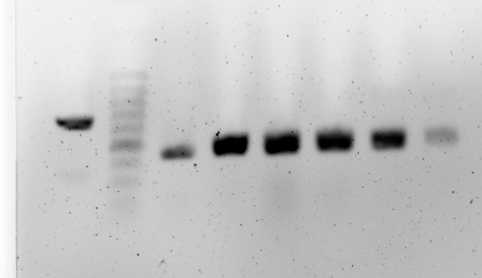
2013_09_05 Colony PCR control and pTac version
Wells 90-96
Inoculate tomorrow
Wells 97-102 are perfect
Inoculate tomorrow

Slide 15
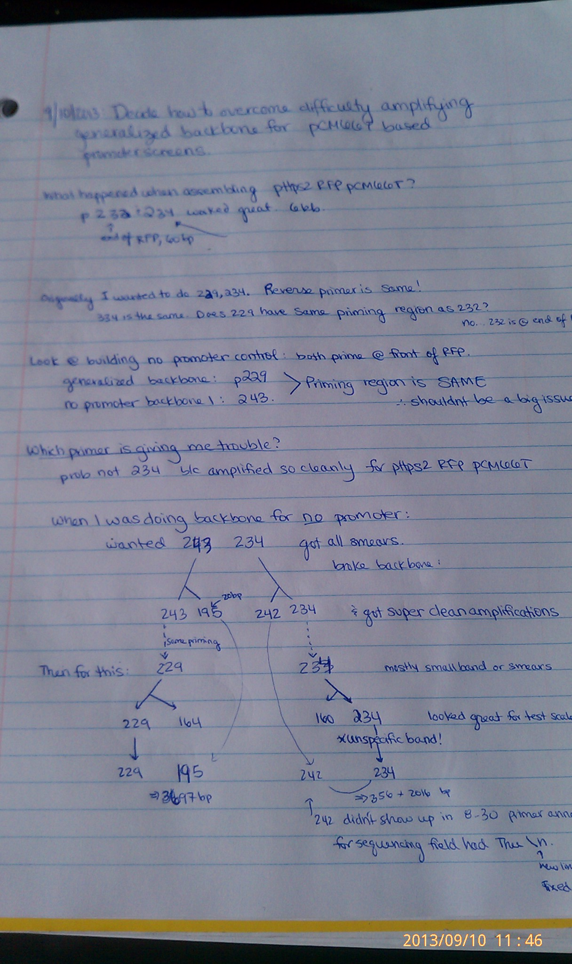
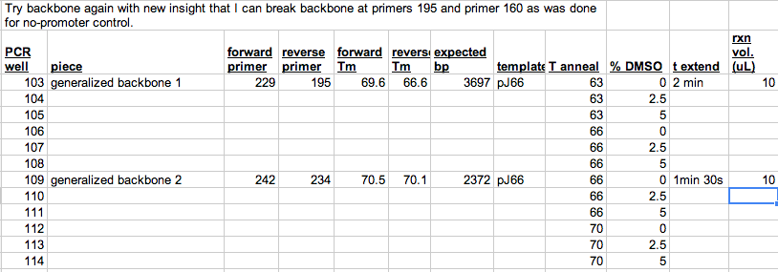
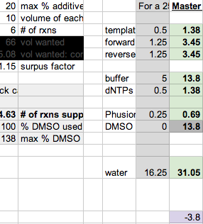
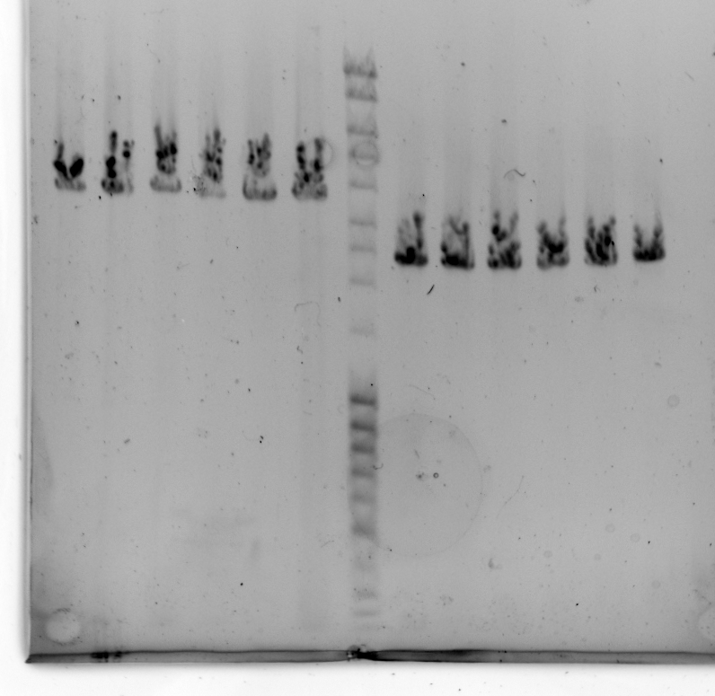
2013_09_05 make generalized backbone
Wells 103-114
Looks awesome. Do purification scale.

Slide 16
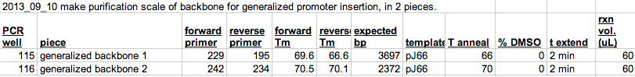


2013_09_05 make generalized backbone

Slide 17

2013_09_11: build pHps2 and pTrc promoter probes

Slide 18





2013_09_11: build pHps2 and pTrc promoter probes
I think all the colonies on this plate are template carry-through. Why aren’t any pink??
Wells 135-143
Why didn’t + control amplify??
Is the 1st well on the R of the ladder?
no.. It is too big. Closer to 800 bp.
Re-run on new gel to make sure I restreak the right colonies.
Did. Well 135 was to left of ladder.
Thus restreak D2, D4, D6, D8

Slide 19


2013_09_11: build pHps2 and pTrc promoter probes

Slide 20



2013_09_11: build pHps2 and pTrc promoter probes
Col 1-8
pCM66
Col 1-8
Restreak #s E1, E2, E6, E7, E8
pCM66

Slide 21
2013_09_03 remove pHps2 from pJ66 (pHps2 RFP pCM66T)

